Slide 1
USAID Zambia Evidence For Health (E4H)
PRESENTATION ON Family planning HEALTH INDICATORS - DHIS2 data FOR 2018-2021
Zambia Evidence for Health Project
March 2022

Slide 2
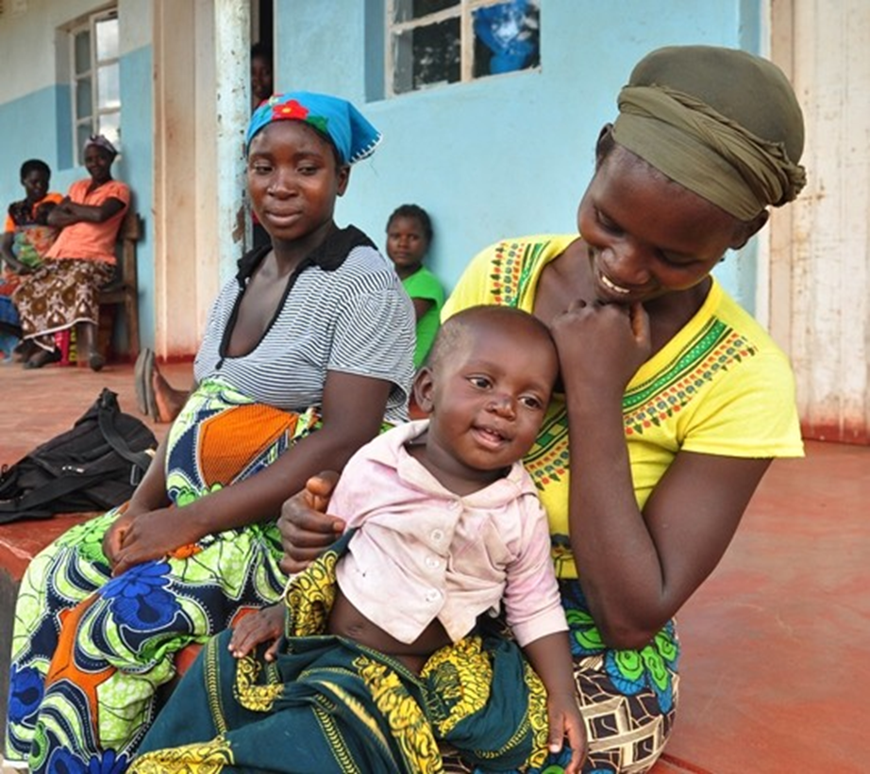
FAMILY PLANNING
Photo credit: John Healy for USAID

Slide 3
Overview of Data Trends 2018 - 2021
Data now covers all of 2021 – will look at cumulative trends since 2018
Categorize data into trending positively, negatively, and remaining consistent
Trends are VERY slight – DO NOT PANIC!

Slide 4
Reviewing Data
Changes in trends – always look for any outliers
Understand data strengths and weaknesses
Things to keep in mind for additional data analysis
Look at areas for primary research to look into some trends

Slide 5
Family Planning Indicator Dashboard
Negative Trend | No Change | Positive Trend
Women of reproductive Age Visited by the CHA | Proportion of new FP acceptors | Clients accessing LARC
Women in reproductive age group on a modern FP method | Modern FP Method Used – medroxyprogesterone injection DMPA-IM and Medroxyprogesterone injection DMPA-SC continue to be the most popular method, with DMPA IM being the more popular of the two | Coverage of modern FP initiation for reproductive age women visited by CHA
Percentage of clients discontinuing LARC | IUCD CopperT remains more popular than IUCD Hormonal
 | Jadelle remains the more popular implant than Implanon

Slide 6
POSITIVE TRENDS

Slide 7
Quarterly proportion of clients accessing long-acting reversible contraceptives: 2018-2021

Slide 8
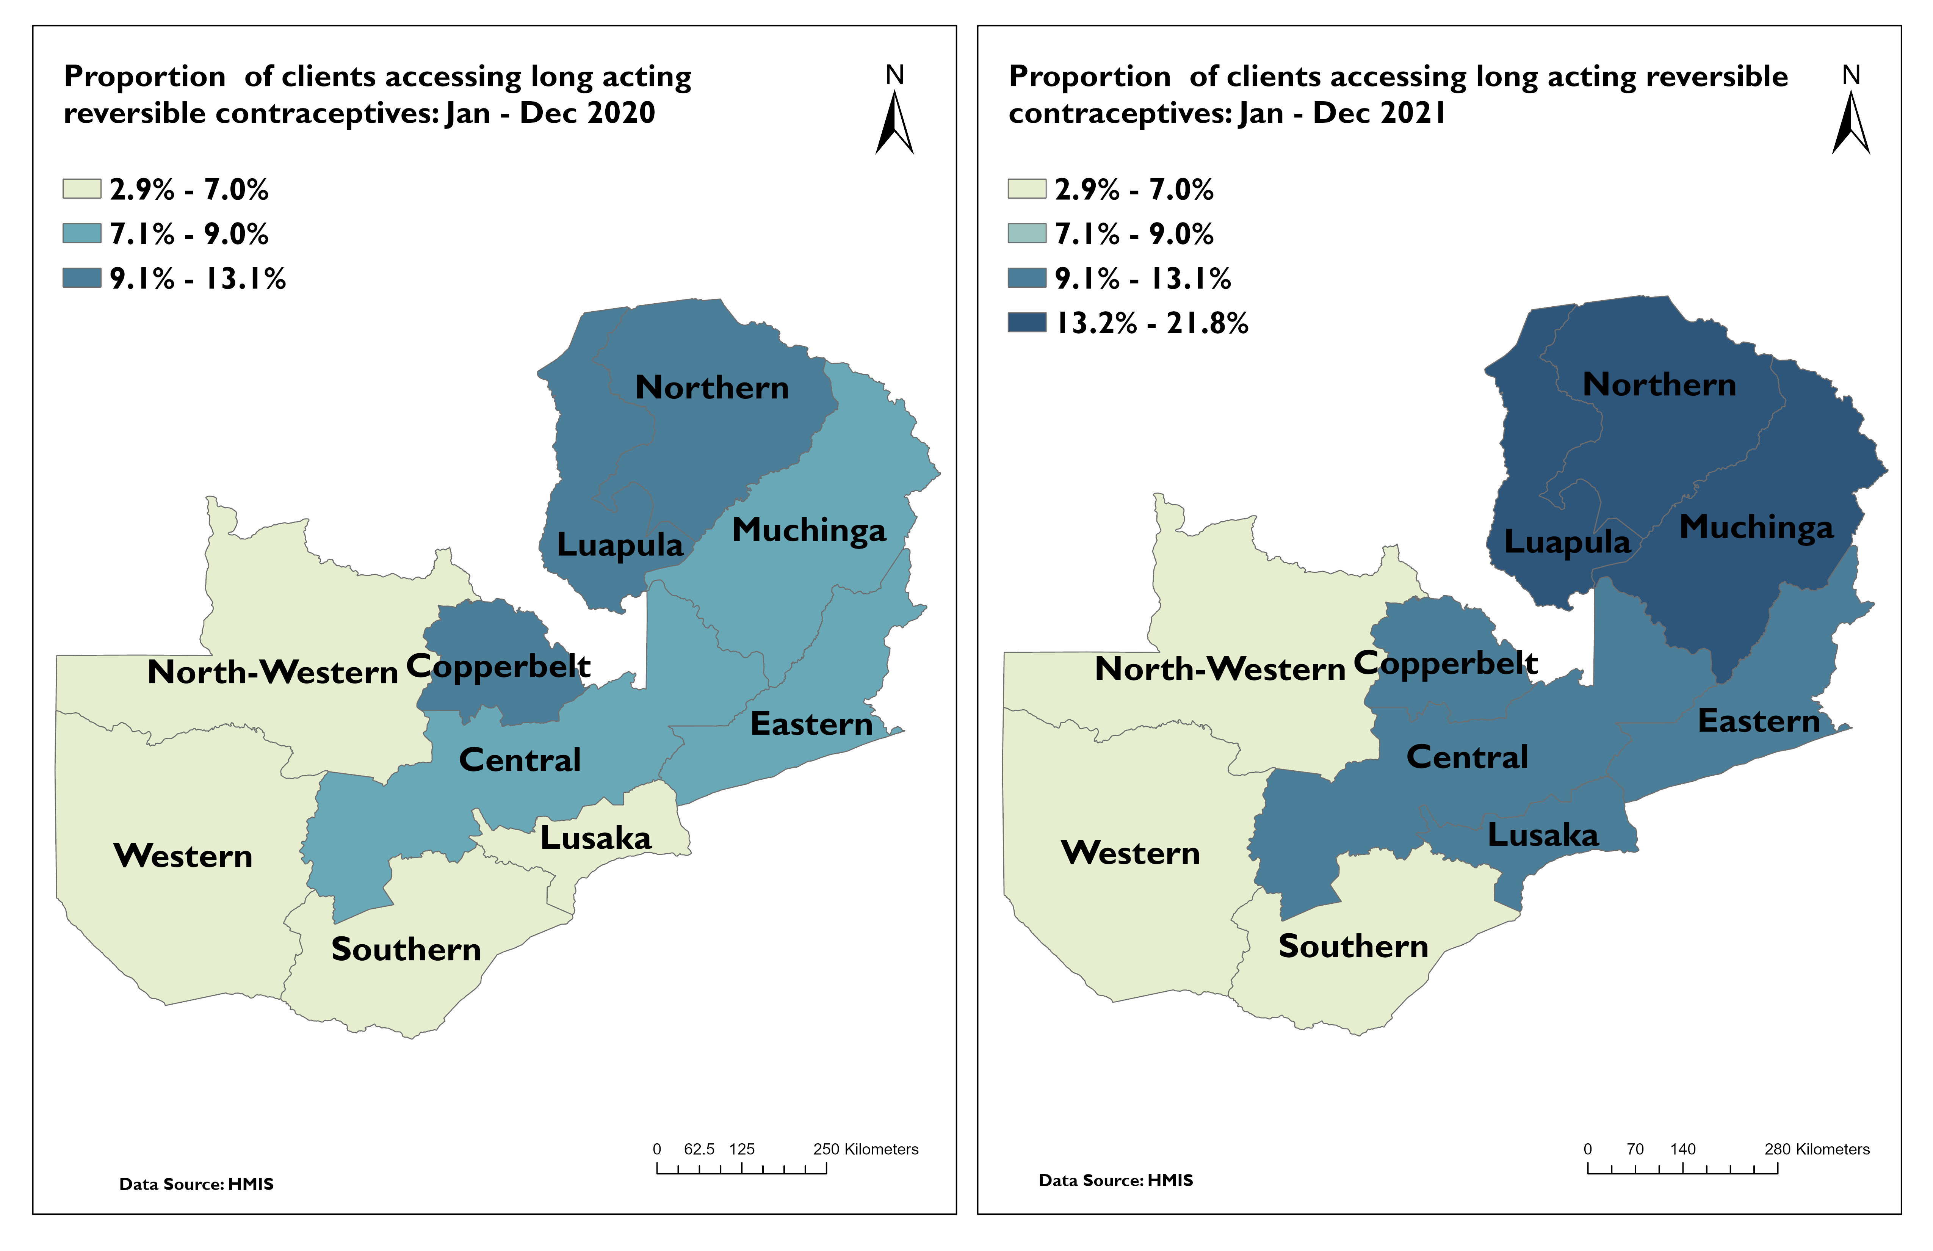
Proportion of clients accessing long-acting reversible contraceptives: Jan – Dec 2020 & 2021
Notes:
Overall, between 2020 and 2021, Lusaka, Central, Eastern, Luapula, Northern and Muchinga all saw increases in LARC access.

Slide 9
Monthly proportion of clients accessing long-acting reversible contraceptives: Jan – Dec 2020 & 2021
Notes:
The trend of increasing use of LARC continues through the first 9 months of 2021 however, the numbers drop sharply in November and December.

Slide 10
Quarterly number of clients accessing LARC by Quarter from 2018-2021
Notes:
While the numbers were overall up in 2021, we saw a clear decrease in the numbers by 4th quarter of 2021, in particular for implants. Muchinga, Northern and Eastern Provinces saw the highest drops in November and December.

Slide 11
CONSISTENT TREND

Slide 12
FP New Acceptors age 15 – 49 years by Quarter from 2018-2021

Slide 13
Family Planning Attendances New Acceptor (starting FP): Jan – Dec 2021
Notes:
January has low performance due to change in the reporting and recording tools which were revised and started reporting on age disaggregation. The highest age range for new acceptors continues to be 25 years and older.

Slide 14
Modern FP method: Jan – Dec 2021
Notes:
DHIS2 data show that medroxyprogesterone injection DMPA-IM and Medroxyprogesterone injection DMPA-SC continue to be the most common modern FP methods

Slide 15
Medroxyprogesterone injections 2021
Notes:
The DMPA-IM continues to be more popular than the DMPA-SC

Slide 16
IUCD- CopperT and Hormonal US for Jan to Dec 2021
Notes:
CopperT still remains the most popular method

Slide 17
Uptake of Implants (Jadelle and Implanon)
Notes:
Women prefer Jadelle to Implanon

Slide 18
NEGATIVE TREND

Slide 19
CHA- Women in Reproductive Age Group visited on Modern FP Method 2018-2021

Slide 20
Coverage of modern FP initiation for reproductive age women visited by CHA: Jan – Dec 2018 to 2021

Slide 21
Quarterly percentage of clients discontinued long-acting reversible contraceptives from 2018 - 2021
Notes:
There was out outlier in 6 districts in the removal of Implants in Q4 Chisamba (1), Luano (1), Mkushi (1), Serenje (1), Lusaka (1) and Mpika (2)
IUCD removal remains consistent.

Slide 22
Number of FP implants and IUCD’s removed by Quarter from 2018-2021
Notes:
There was out outlier in 6 districts in the removal of Implants in Q4 Chisamba (1), Luanon (1), Mkushi (1), Serenje (1), Lusaka (1) and Mpika (2)
IUCD removal remains consistent.

Slide 23
Areas to Follow Up 1. December dip - Chisamba (1), Luano (1), Mkushi (1), Serenje (1), Lusaka (1) and Mpika (2) implant removal data verification Definition of the CHA and if it includes CBDs Stock outs – other partner working on this

